Slide 1
Alarm Clock Operation in mobile Phones
GUIDE

Slide 2
Submitted By
NAME Reg.No

Slide 3
Introduction
An alarm clock is a clock that is designed to make a sound, or some other signal, at a specific time.
The primary utility of these clocks is to awaken people from their night's sleep or short naps
The mobile phones feature the ability for the user to set multiple alarms, each with different songs or playlists, or to play a random song or playlist
Do not fails to make buzzer even though the mobile is switched off.

Slide 4
ABSTRACT
The Real-time clock (RTC) is a computer clock that keeps track of the current time
RTCs are present in almost any electronic device which needs to keep accurate time.
The clock is typically powered from batteries.
After setting the alarm, it waits for reaching the trigger.

Slide 5
AIM OF THE PROJECT
To set Aalarm in Mobile Phone

Slide 6
SYSTEM REQIREMENTS
Operating System
Windows Xp/Windows7
HARDWARE REQUIREMENTS
Cellular Phones
Intel® Pentium® CPU B940@2.00GHz 2.00 GHz
RAM 512MB and more

Slide 7
CONTD…..
SOFTWARE REQIREMENTS
Net Beans IDE6.1
Internet Explorer

Slide 8
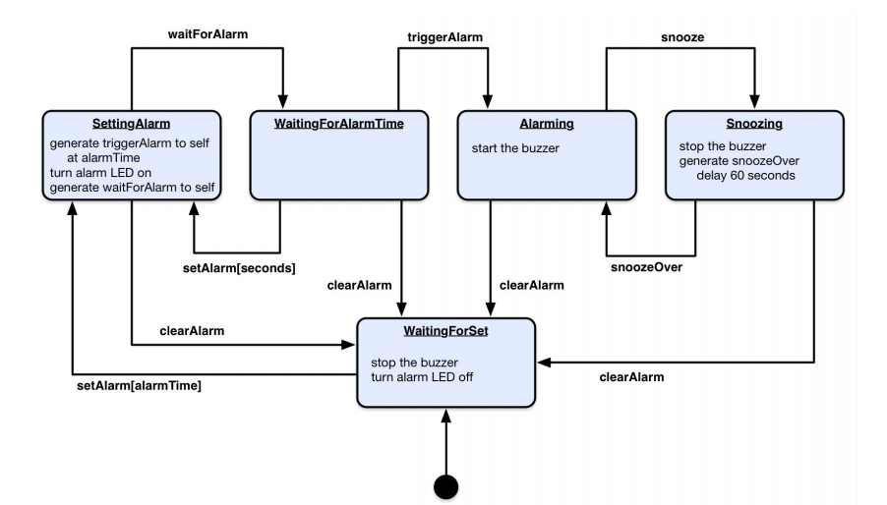
Block Diagram

Slide 9
EXISTING SYSTEM
A classic analog alarm clock has an extra hand or inset dial that is used to specify the time at which to activate the alarm.
In some models, the back encasement of the clock itself acts as the bell.

Slide 10
PROPOSED SYSTEM
We can set multiple alarms, who have different waking up schedules.
Can be configured to sound an alarm that slowly increases in volume or vibration intensity until you dismiss it or after successive snoozes

Slide 11
ADVANTAGES
To make alarm in mobile is easy.
In this, alarm time is accurate
Do not fails to make buzzer even though the mobile is switched off.
We can set as many alarms as you want, at any time of day, in both 12 and 24 hour format

Slide 12
CONCLUSION
In previous alarm clock have some disadvantages comparing with our project.
Finally, this system should be further developed so that it will have more features.
In previous analog alarm clock have some disadvantages comparing with our project.

Slide 13


Slide 14
Questions and Comments?

